Slide 1
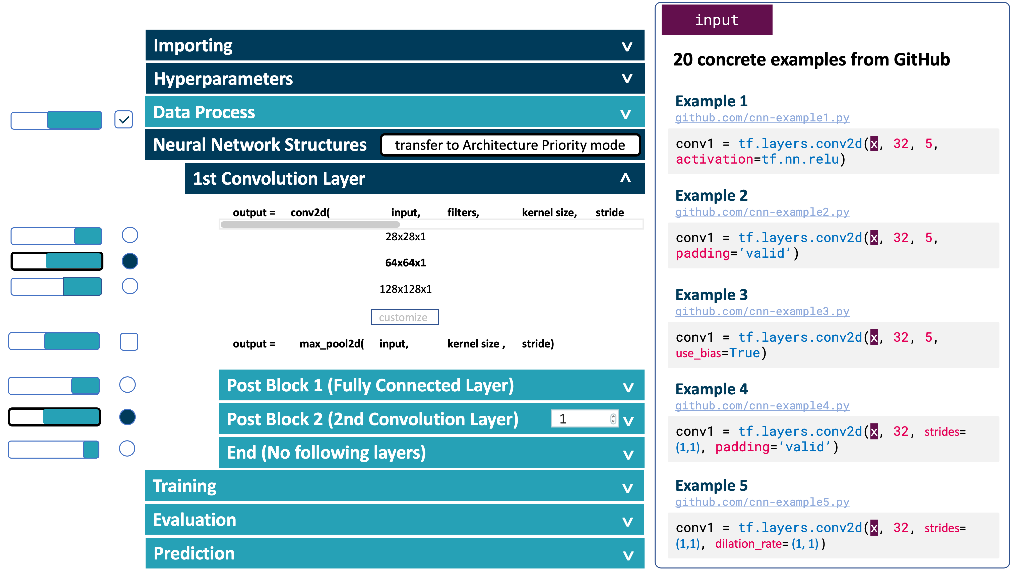
Neural Network Concept Hierarchy
Distribution Bars
Code Examples

Slide 2
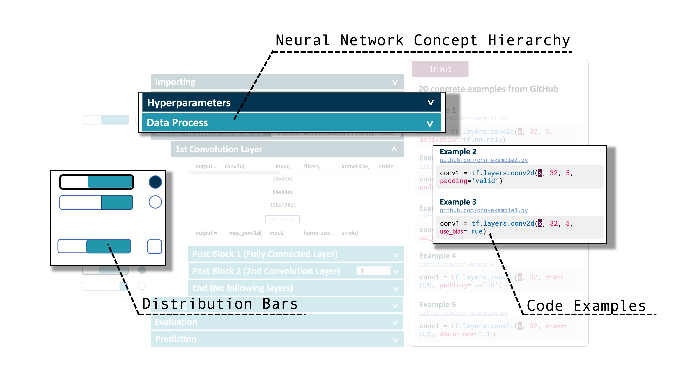
The Design A enables the professional users to build the neural networks by defined procedures. Each concept contains some detailed parameter settings and layer settings.
Pros: Easy to find the information.
Cons: Constrain you to follow the procedure.

Slide 3
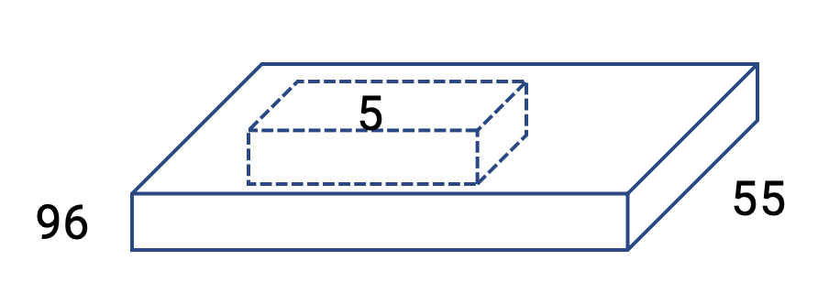
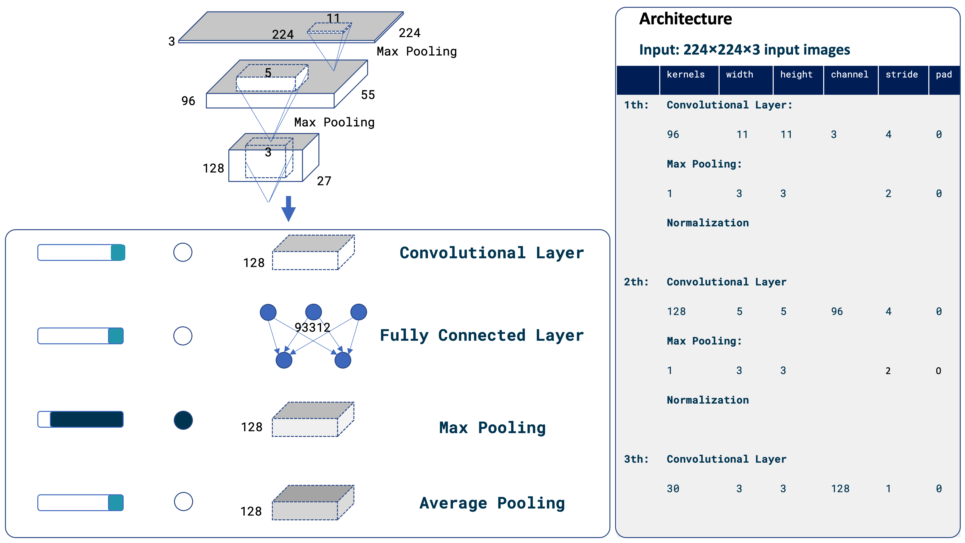
Neural Network Architecture Graph
Layer Parameters
Layer Selection

Slide 4
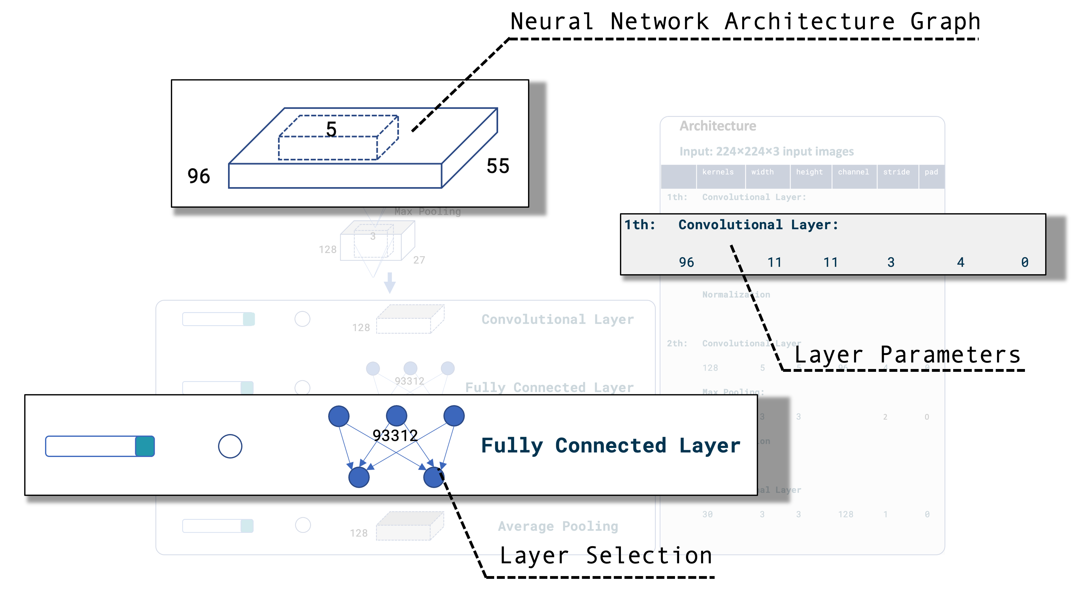
The Design B enables the DL beginners to build the neural networks through the graphic selections.
Pros: Easy to understand.
Cons: Too much missing information.

Slide 5
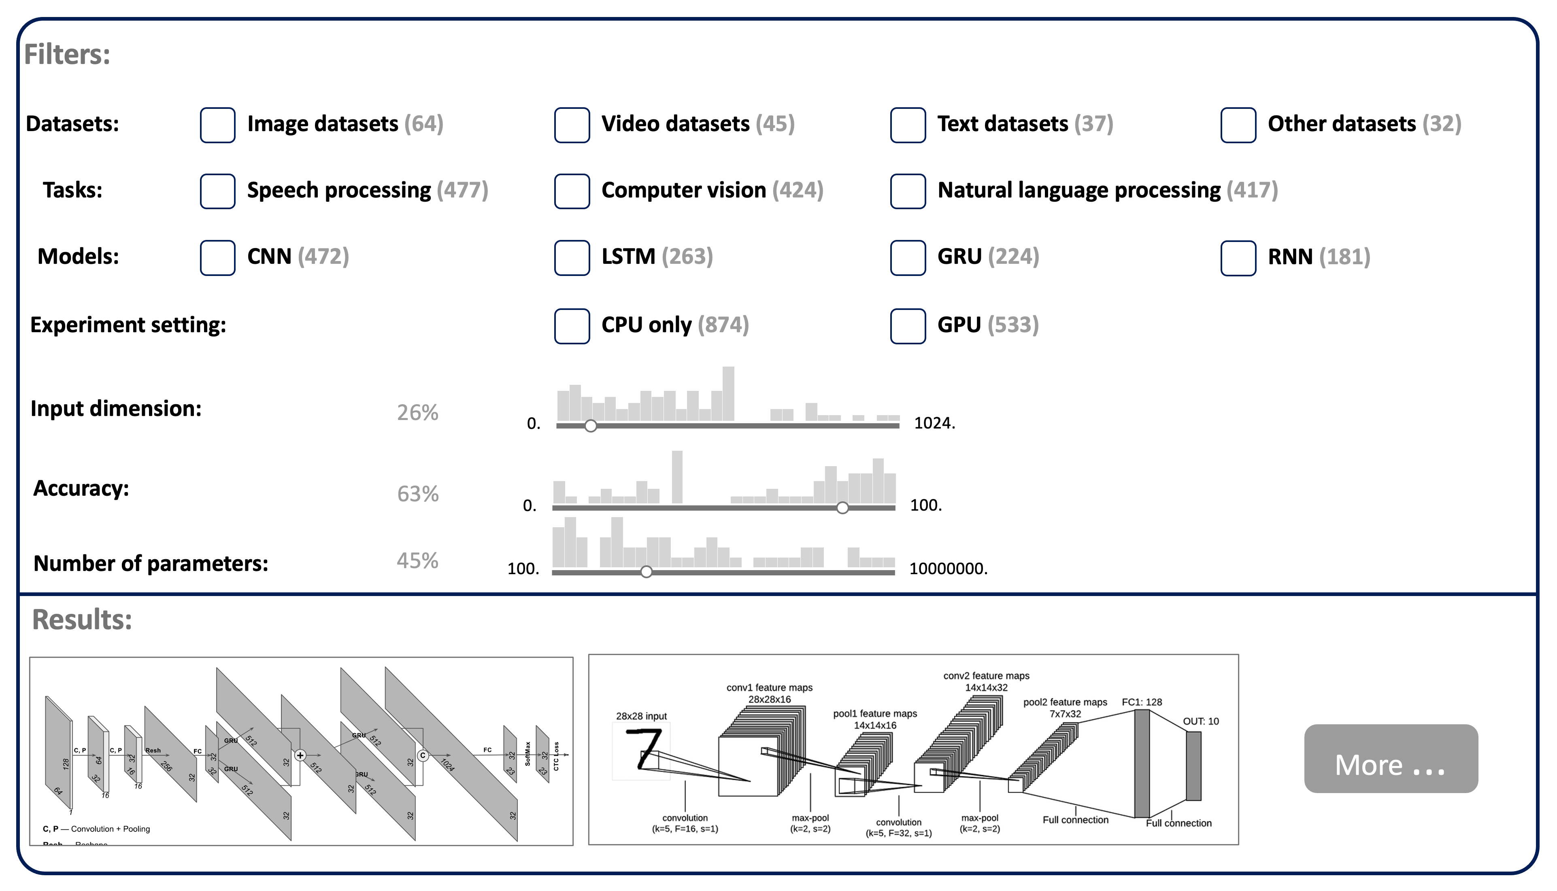
Multifaceted browser
Distribution bar with slider
Model Architecture Graph

Slide 6
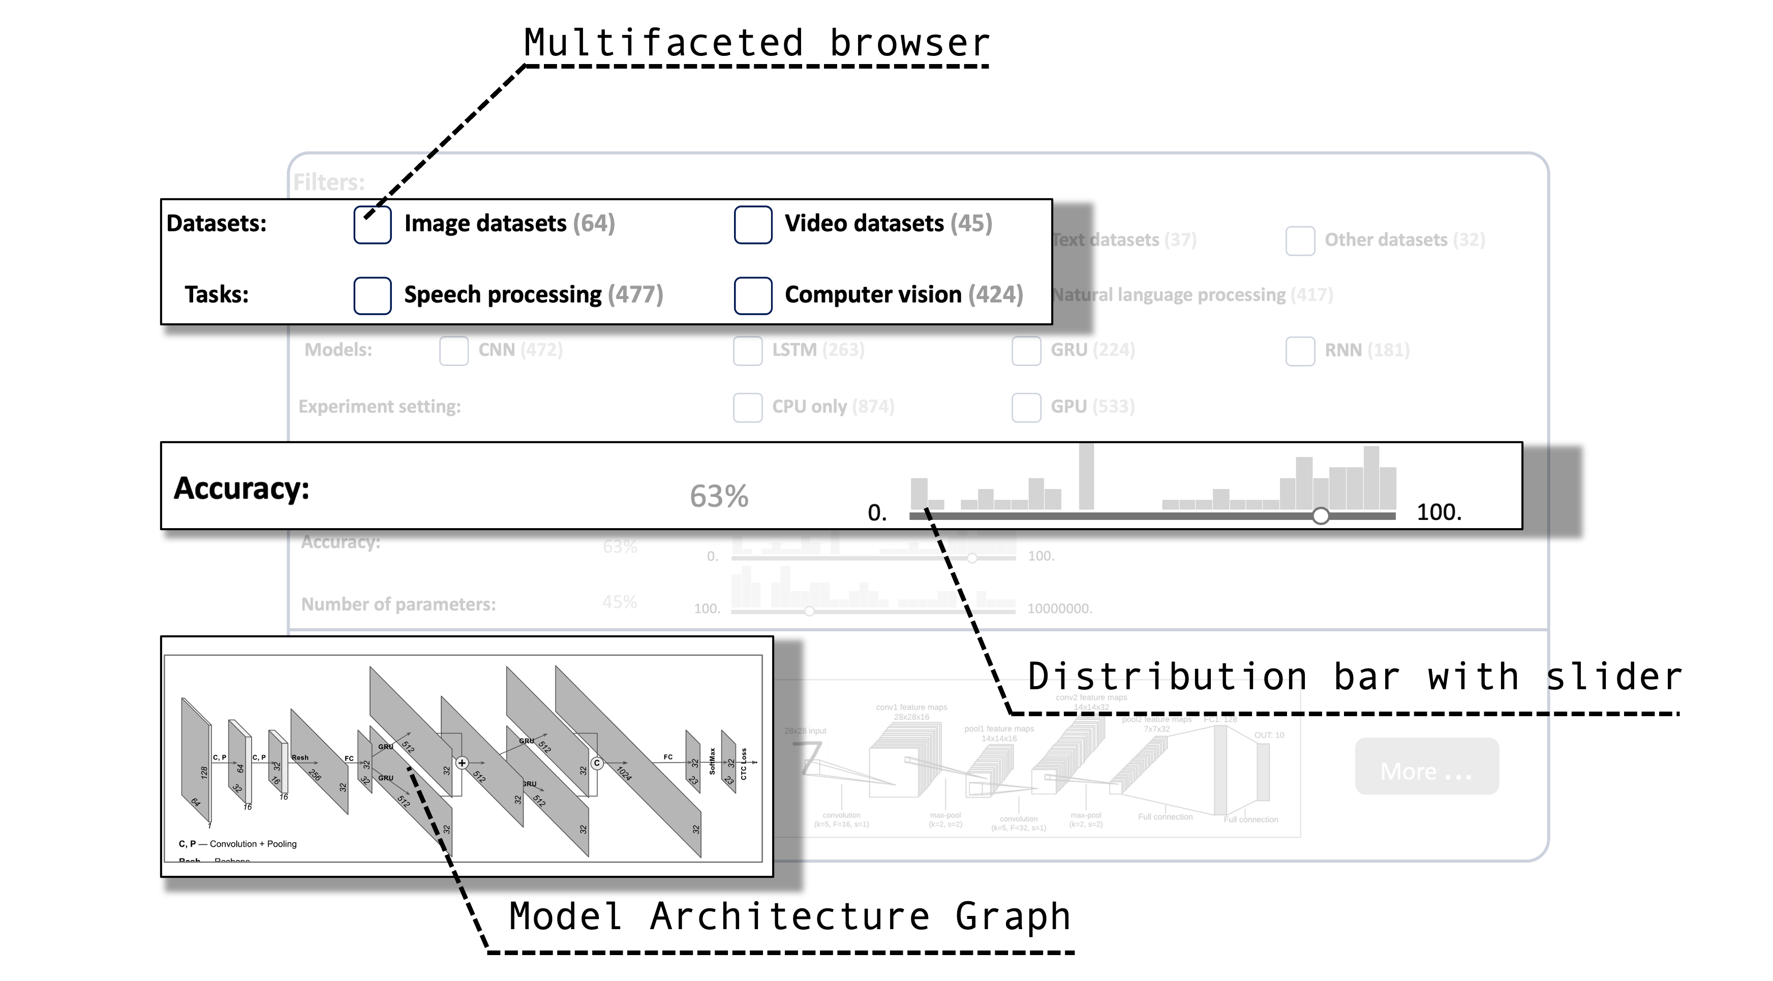
The Design D provides a multifaceted browser to allow users to select suitable datasets, tasks, models types, and training information.
Pros: The filter is helpful.
Cons: Lack parameter settings.

Slide 7
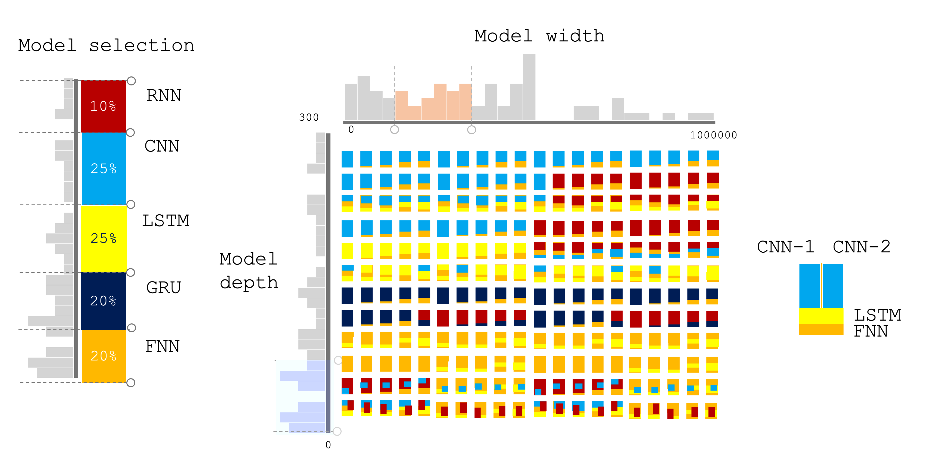
Model selection
Model architectures
Depth selection

Slide 8
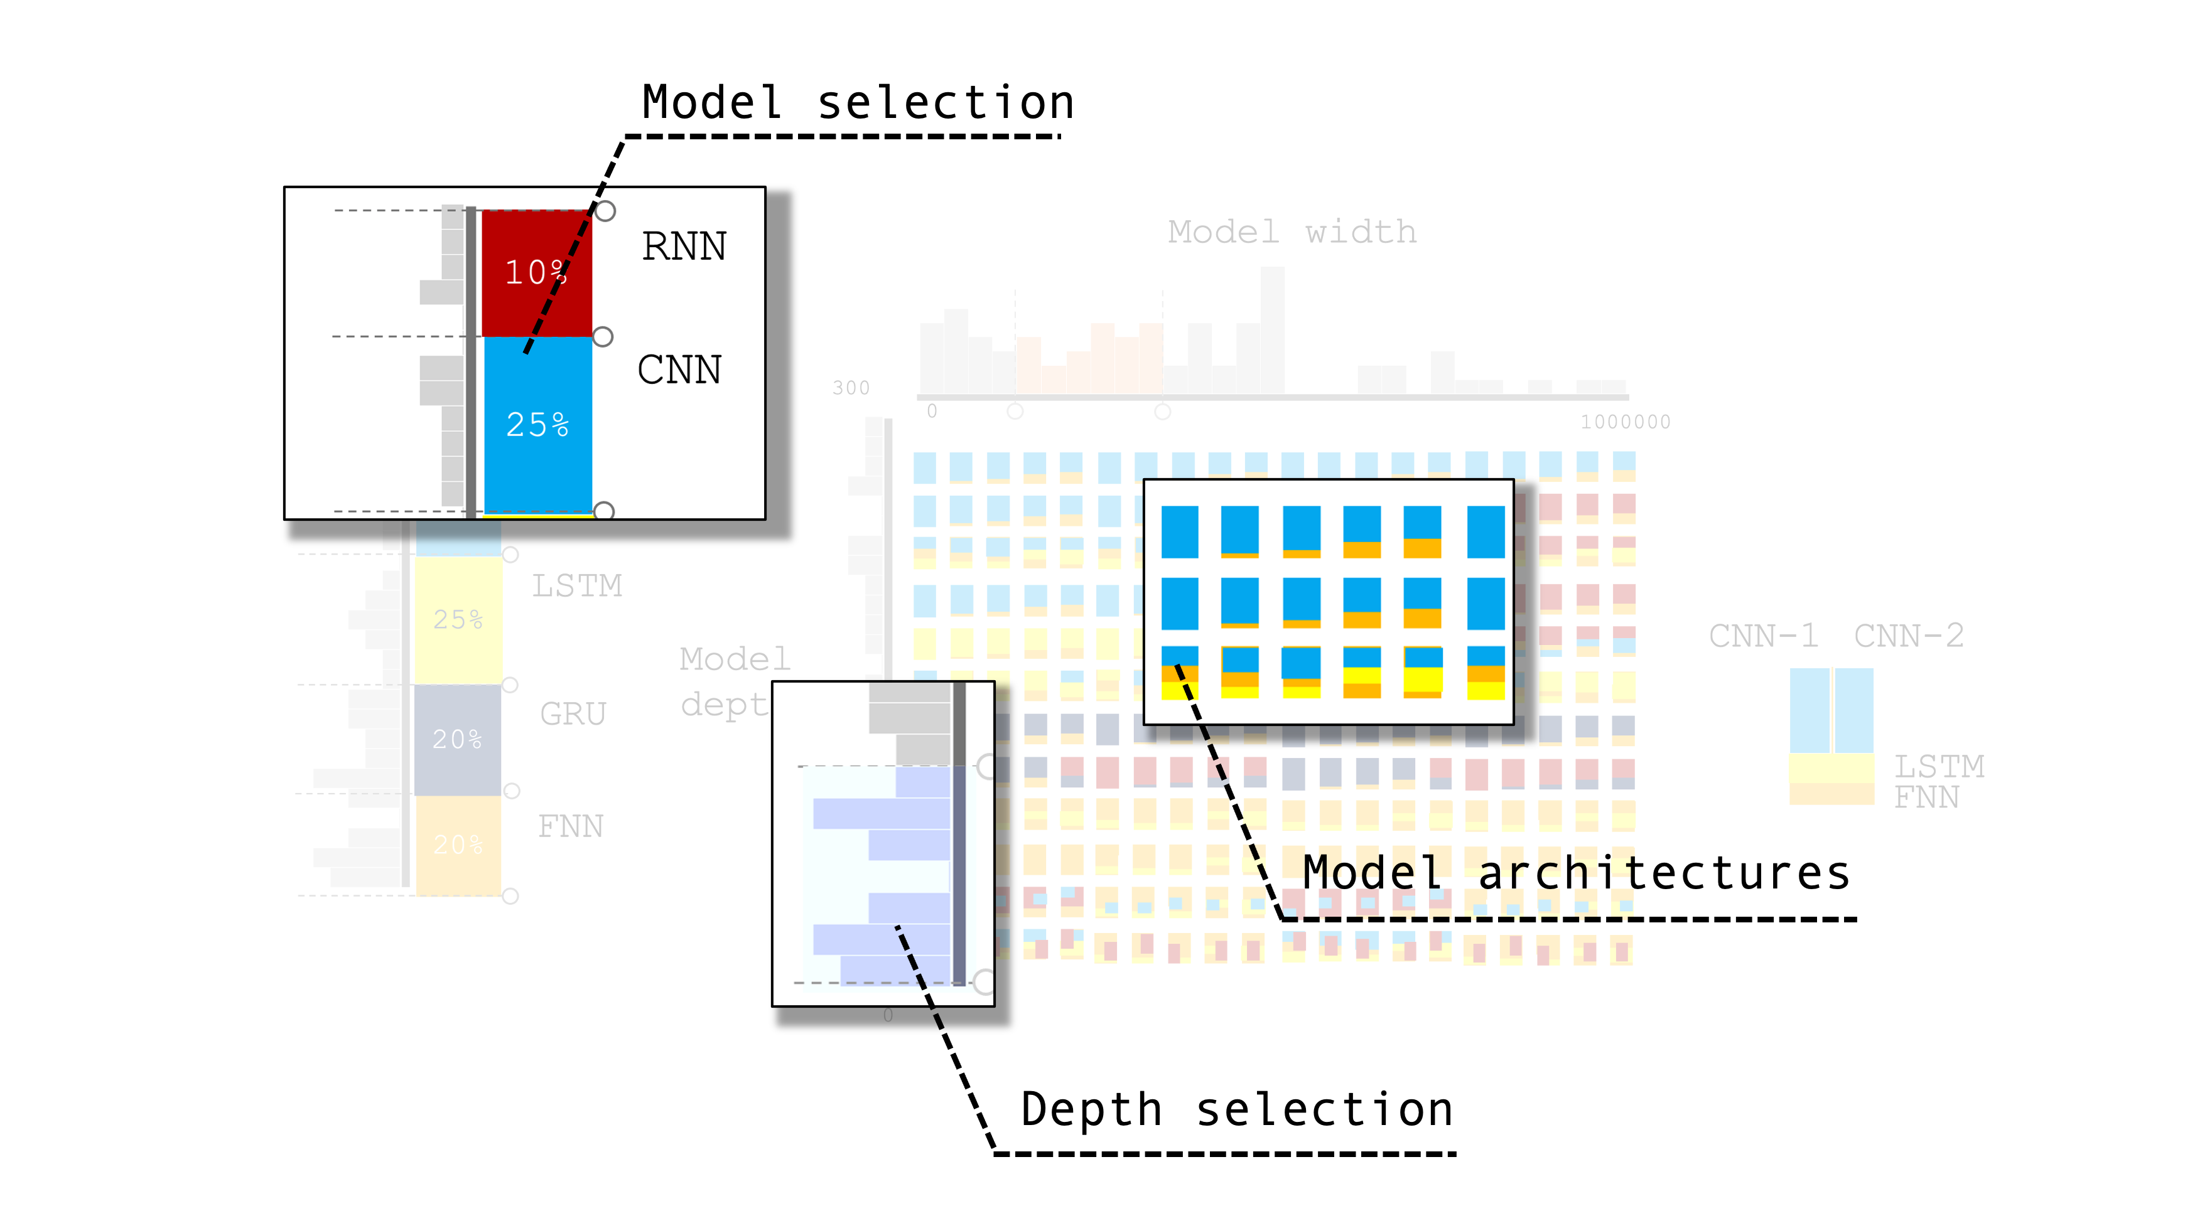
The Design E provides an overview of hundreds of neural networks. Users can use the model types/width/depth selections to filter the models.
Pros: Present multiple models in a single view.
Cons: Lack detailed layer settings and parameter settings.

